Slide 1
Bank loan Analysis
Name :Vandana Chandel

Slide 2
Table of Contents
01
02
03
04
Datasets
Given datasets ,its domain type and size.
KPI’s
Put the insight of given Kpi’s by using different visualization tools.
Data story telling
Describe the insights using kpi’s give the depth analysis.
Conclusion
Make the strategies according to the business requirement

Slide 3
Datasets
Domain
Dataset type
Dataset size
Domain : Finance
Project: Bank loan of customers
Datasets: Finance_1.xlsx & Finance_2.xlsx
Dataset Type: Excel Data
Dataset Size: Each Excel file has 39k+ records

Slide 4
Project purpose and significance
Here’s why this project is crucial and significant
Strategic Insights for informed decisions: By analyzing loan amounts year-wise , the project provide an overview of changing borrowing patterns. This data informs financial institution about peak demand periods and help them allocate resources effectively, ensuring timely and competitive loan offerings.
Risk Assessment and Portfolio Management : Visualizing sub-grade and grade wise revolving balance enable institution to assess credit utilization and pattern among different borrower segments. This insights guide risk assessment strategies and support effective management of loan portfolios, ensuring balanced risk exposure.
Verification Status Analysis: Differentiating between “verified” and “non-verified” loans give insight into institution reliance on verified borrower information. This analysis is essential for ensuring prudent lending decision, minimize potential risk associated with unverified data.
Regional Loan performance: Examining loan status across states based on last credit pull dates offers geographical insight into reginal loan performance. This information help institution tailor their lending strategies to specific region and ensure the targeted risk management and responsive borrower support.
Enhance Operational Efficiency: The Dashboard’s consolidated view of critical KPI’s empower institution to streamline operations. By optimizing process, institute can allocate resources effectively, reduce operational redundancies, and enhance overall efficiency, leading to cost savings and improved customer experience.

Slide 5
Data Analysis process
01
02
COLLECT THE DATA
DEFINE THE QUESTION
Drive it in different tools
Understand the given KPI’s
ANALYZE THE DATA
CLEAN THE DATA
03
04
Tool used my sql
Tool used Excel and Tableau
VISUALIZE AND SHARE THE INSIGHTS
05
Tool used power bi, Excel and Tableau

Slide 6
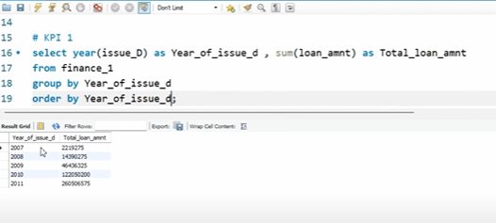
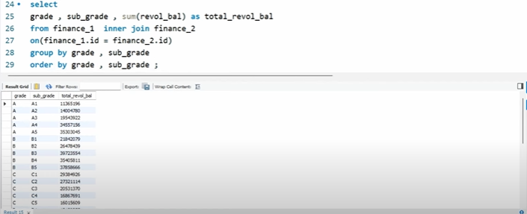
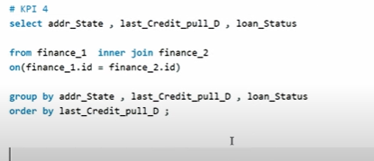
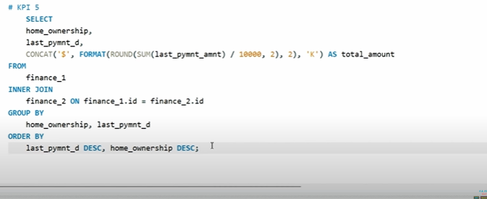
Analyze the data
Analyze the given KPI’s queries, check in my SQL

Slide 7
KPI’s
01
02
Grade and sub grade wise revol balance
Year wise loan Amount Stats
Tool used Tableau
Tool Used Tableau and MySQL
State wise and month wise loan status
Total Payment for verfied and non verified status
03
04
Tool used power bi
Tool used Excel and Tableau
Home ownership vs last payment date stat
05
Tool used power bi

Slide 8
01
Year wise loan_amnt
Tool used Tableau and My sql

Slide 9
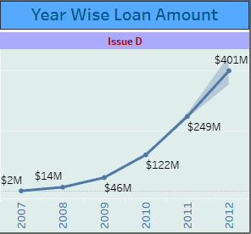

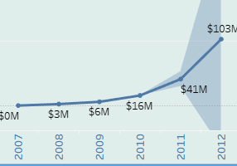
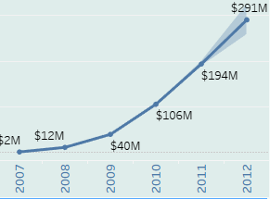
Year wise loan amount
In this kpi, it is clearly visible tht loan amount has been incresing in going year from the 2007 to 2011 , as it $249M in 2011 and the lowest in year 2007 that is $2M.
With the use of Tableau we can also forecast the coming year loan stats which has been increasing as it cn go upto $401M.
If we add the loan status in the analysis it show 3 otion here of loan : chraged off , current and Fully Paid.
Charged off are those customer who did not fully repaid their laon and it is maximum in predicting phase that would be 2012 with $103M .
Fully Paid are those who fully paid their loan and tht would be maximum in 2012 with$291M.

Slide 10

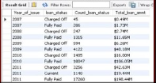
Current are those customer who are repaying their loan on regular basis.
So we can conclude that fully paid customer are more slightly greater than charged off customer and current holding status customer are lowered compared to both.
By analysis the Yaer wise loan stats , bank should take actins like effective recovering startegies, proactive communication and Risk assessment that can redued the charged off status of the customer of the bank and increase their performance.

Slide 11

02
Grade and sub-grade wise revol Balance
Tool used Tableau

Slide 12
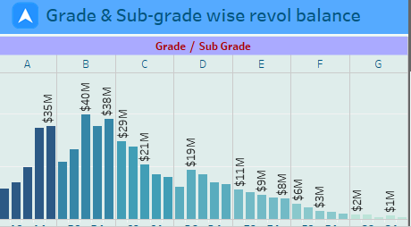
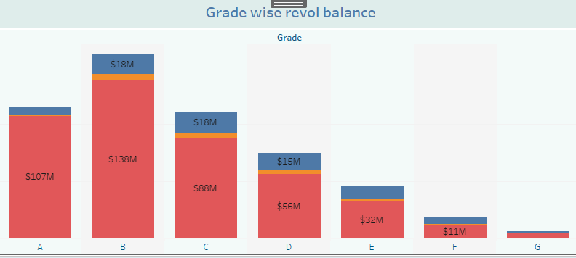
Grade and sub grade revol balance
In this Kpi we can see that the Grade B has highest revolving balance $40M as compared to other grade and sub grade wise and Grade G has lowest revolving balance
Revolving balance that carries over from one month to the next on that loan.
High revolving balances may indicate that a borrower is relying too much on credit. That is why it is important to keep revolving balances to a minimum.

Slide 13
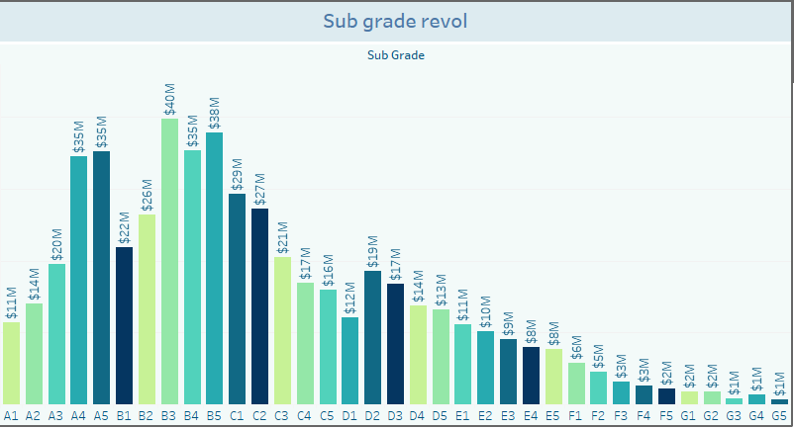
For Further analysis, we can say that Grade A has second highest revolving balance and in which sub-grade A4 and A5 have the maximum revolving balance which is $35M.
So Here we analysis that maximum no. of customer in Grade B and minimum no. customer in Grade G.
It can be concluded here that bank should encourage responsible credit utilization to minimize revolving balance across all loan grades.
We should encourage our customer to pay their loan payments on time( at the end of each month) so that we can reduce revolving balance across all loan grades.

Slide 14
03 Total payment for verfied status and non verified status
Tool used Excel and Tableau

Slide 15
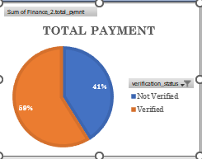
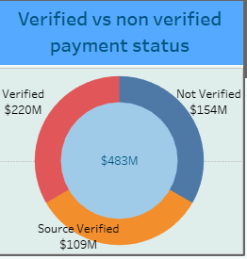
Total Payment volume: The total payment volume for both verified and non verified status combined is 220M+154M =$483M.
Perecentage for verified status is 59% and Percentage of non verified status is 41%.
Comparitive Analysis: Verified users contribute larger portion of total payment compared to non verified users.
The data suggest that having verified status may positively impact payment behaviour as verifird user contribute a larger shatre of total payment volume.
Based on this analysis, it may be beneficial to focus on increasing the number of verified users or encouraging non verified users to verify their accounts,as it could potentially lead to increase payment volumes.

Slide 16
04
State wise and month wise loan status
Tool used power bi

Slide 17
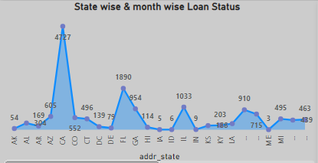
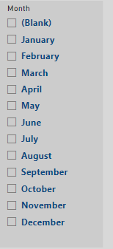
Analyzing loan data by state reveals that California(CA) ,New York (NY) and Florida(FL) are the leading consumer with following breakdown:
Fully paid loan :5.8k(CA),3.2k(NY),2.9k(FL)
Charged off: 150(CA),114(NY),85(FL)
Current Paying Loan:1.1K(CA),495(NY),504(FL)
Maine(ME),Lowan (LA),and NE exhibits the lowest loan consumption at 3(Fully paid),5(Fully paid ),3(Charged off) and 2(Fully Paid ) Customers.

Slide 18
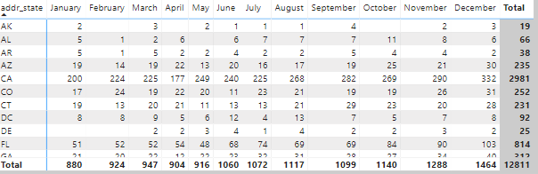
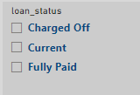
Our loan data shows that December had the highest loan activity. In December, the total loan disbursed in 1464 customer in which 246 are charged off ,Current are 64 and 1154 are fully paid out customers.
Conversely, February had the lowest overall loan activity. While the fully paid customer in February are 814, the charged off customer in ebrary was significantly lower at 110.

Slide 19
05 Home ownership vs last payment date stat
Tool used power bi

Slide 20
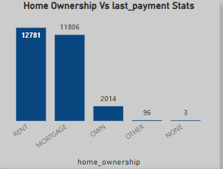
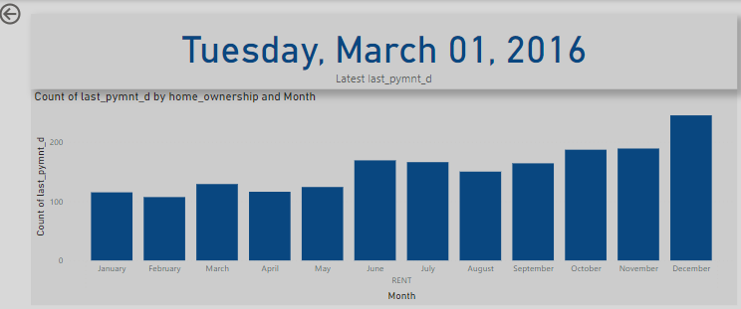
The key finding from home ownership data analysis is the prevalence of renters, constituting roughly 12k customers.
This highlight a significant segment of population that may interested in future homeownership opportunities .
Understanding the factors influencing their renting decisions can be crucial for developing targeted strategies to promote homeownership within this demographics.
Other home ownership category is not worthy having fewest customer with only 96 individuals.

Slide 21
This relatively small segment may represent a diverse group of ownership arrangements not captured by the standard categories. Further investigation into this category could potentially reveal valuable insights into alternative or emerging home ownerships trends.
As we can see , Tuesday March 2016, is last payment stats, through which we can also see the monthly loan activity. An analysis of last payment dates between 2008 and 2016 revels that 2013 witness the highest loan repayment activity, with approximately 9.5k customer making their final payment.

Slide 22
Dashboards
Interactive dasboards using Excel, Power BI and Tableau

Slide 23
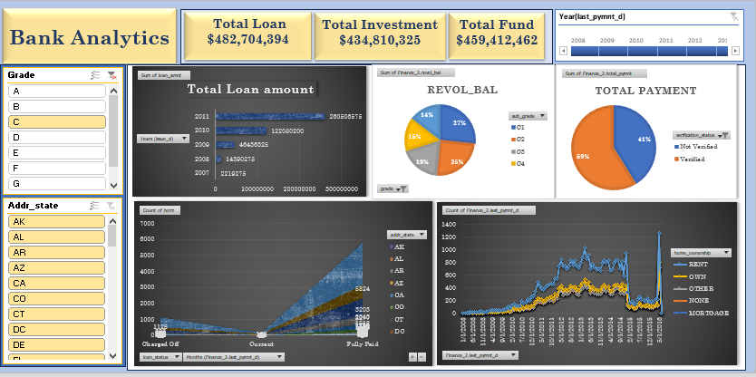
Dashboard using Excel

Slide 24
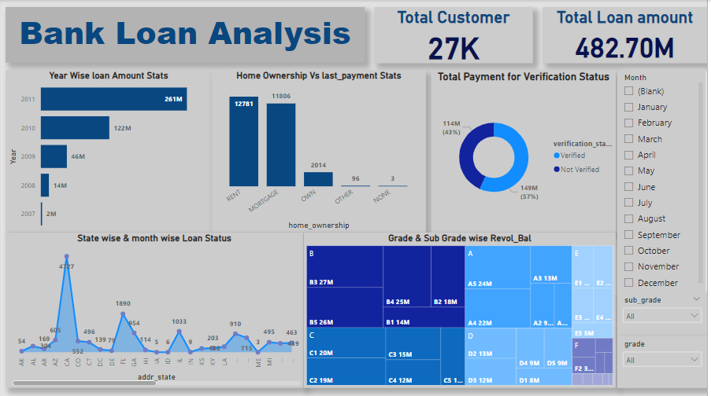
Dashboard using Power BI

Slide 25
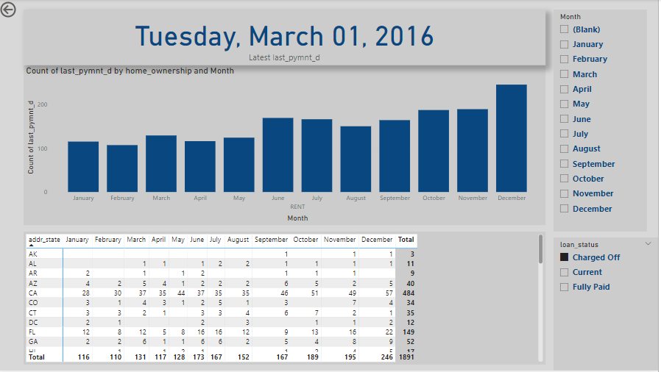

Slide 26
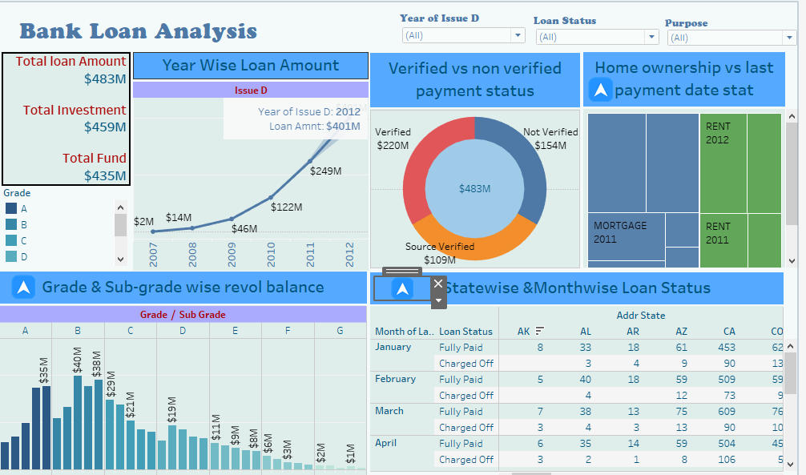
Dashboard using Tableau

Slide 27
Conclusion
The conclusion from the Bank loan Analysis Project based on the specified key Performance indicators:
Year wise loan Amount status: The project analyzed loan amount over different year. It is essential to monitor trends in loan applications and disbursements to understand the bank’s lending strategy and overall health of loan portfolios.
Grade and sub grade wise Revolving Balance: Focusing on creditworthiness (grade and sub-grades), the project likely assessed the revolving balance associates with different loan categories. This information aids in risk assessment and portfolio managements.
Total payment for Verified and non verified status: By comparing payment for verified and non verified loans, the project likely identified patterns related to borrower credibility. Verified loan may have higher payment compliance while non verified loans could exhibits varying payment behavior.
State and Month wise loan Status: The project explored loan status variations across different states and months. This analyses helps identify regions with higher loan demands, seasonal patterns and potential risk areas.
Home ownership vs last payment stat: The project might have investigated how home ownership status correlates with payment behavior. Understanding whether homeowners tend to make timely payments to provide more clarity in loan performance.
Overall, this Bank loan report Analysis project MySQL used for data manipulation, and Power BI , Tableau Excel used for Data visualization to create comprehensive reports. Stakeholders can use these insights to make informed decisions regarding loan application approvals and risk management.

Slide 28
Final tips and takeaways
Strengthen lending standard and risk assessment processes.
Diversify loan portfolio across sectors and types for risk mitigation.
Encourage responsible credit utilization to minimize revolving balance across all loan grades.
Provide education and resources to borrowers to promote responsible payment behavior across all verification status.
Provide personalized support to borrowers in current status for timely payments.
Support resources for managing financial responsibilities of homeowners with outright ownership.

Slide 29

Thanks!

